Slide 1

TD3 Algorithm for Portfolio Management
-Deep Reinforcement Learning-
Group Members:
Jing He
Kexin Zhao
Osman Huzur Solmaz
Sude Dübek

Slide 2
Content
Introduction
Methodology
Problem Definition
Model Building
Conclusion

Slide 3
Introduction

Slide 4
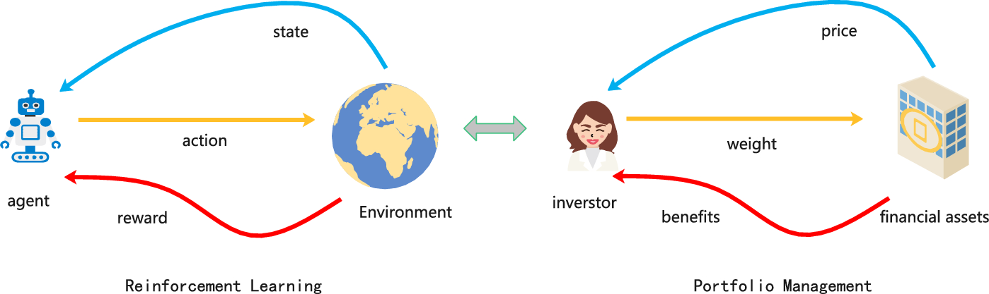
Introduction
Finance Environment:
Dynamic, complex, and large-dimensional
Nonlinear relationships between state and action spaces
Research Background:
Reinforcement learning and deep learning methods have been widely used to solve portfolio selection optimization problems.
Except to consider portfolio return, additional factors such as transaction costs and investor risk tolerance have also been included
Motivation:
Aim to develop an optimal investment policy for investors by utilizing the more advanced TD3 model while integrating transaction costs and risk aversion costs.
Presentation for Deep Reinforcement Learning | Tutor: Maotong Sun

Slide 5
Methodology

Slide 6

Methodology
Pre Processed Data
Close price data from S&P100 stocks(2010-04-01 to 2023-03-09)
Problem Definition
Model Building
Best Model Picking
Conclusion
States
Baseline Methods
1. Minimum Variance
2. Max Sharpe Ratio
TD3-MLP
Model Result Analysis
Action (continuous)
Performance metrics：
Cumulative Return
Annualized Return
Annual Volatility
Sharpe Ratio
Maximum Drawdown
Calmar Ratio
Further Evaluation:
Change Market Condition
Transaction Cost
Risk Aversion Cost
Reward Function
1. Portfolio return
2. Transaction cost
3. Risk aversion cost
TD3-MLP
TD3-LSTM
6

Slide 7
Problem Definition

Slide 8


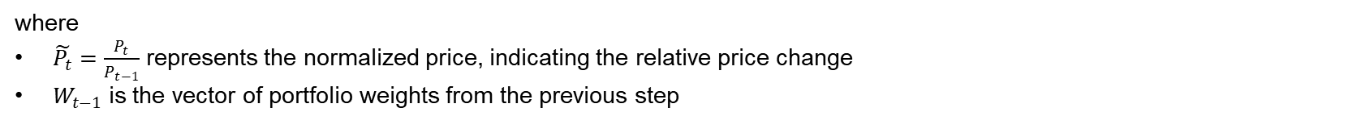
Deep Reinforcement Learning Problem Definition
State, Action and Reward
1. State (s)
The state represents the information available to the agent at each time step. It consists of:
Current asset prices (normalized).
Previous portfolio weights (distribution of capital across assets).
Mathematical Representation:
At time t:
State evolution: As the agent interacts with the market, new states are generated based on:
Current window prices (normalized).
Portfolio rebalancing results
$$s_{t}=[\tilde{P_{t}},W_{t−1}]$$
where
$\tilde{P_{t}}=\frac{P_{t}}{P_{t−1}}$ represents the normalized price, indicating the relative price change
$W_{t−1}$ is the vector of portfolio weights from the previous step
Presentation for Deep Reinforcement Learning | Tutor: Maotong Sun
8

Slide 9

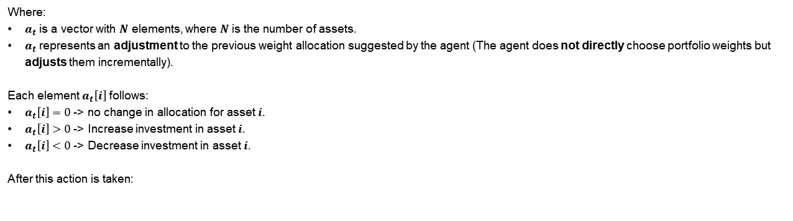
Deep Reinforcement Learning Problem Definition
State, Action and Reward
2. Action (a)
The action determines how the agent rebalances the portfolio. The agent decides:
How much capital to allocate to each asset.
Adjustments to previous weights.
Mathematical Representation
continuous action space
$$a_{t}∈{[−1,1]}^{N}$$
Where:
$a_{t}$ is a vector with $N$ elements, where $N$ is the number of assets.
$a_{t}$ represents an adjustment to the previous weight allocation suggested by the agent (The agent does not directly choose portfolio weights but adjusts them incrementally).
Each element $a_{t}\left[i\right]$ follows:
$a_{t}\left[i\right]=0$ -> no change in allocation for asset $i$.
$a_{t}\left[i\right]>0$ -> Increase investment in asset $i$.
$a_{t}\left[i\right]<0$ -> Decrease investment in asset $i$.
After this action is taken:
$${W_{t}=W}_{t−1}+a_{t}$$

Slide 10

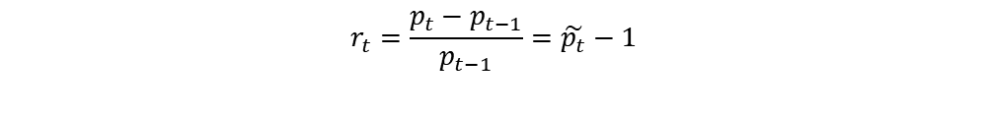

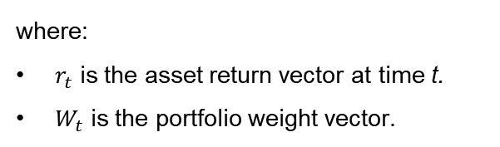
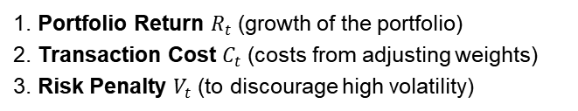

Deep Reinforcement Learning Problem Definition
State, Action and Reward
3. Reward
The reward function evaluates the agent’s portfolio performance by considering:
1. Portfolio Return $R_{t}$ (growth of the portfolio)
2. Transaction Cost $C_{t}$ (costs from adjusting weights)
3. Risk Penalty $V_{t}$ (to discourage high volatility)
${reward}_{t}=R_{t}−C_{t}−$ $V_{t}$
Portfolio Return:
$$R_{t}=W_{t}^{T}r_{t}$$
where:
$r_{t}$ is the asset return vector at time t.
$W_{t}$ is the portfolio weight vector.
$$r_{t}=\frac{p_{t}−p_{t−1}}{p_{t−1}}=\tilde{p_{t}}−1$$
Presentation for Deep Reinforcement Learning | Tutor: Maotong Sun
10

Slide 11
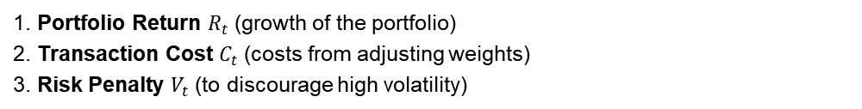
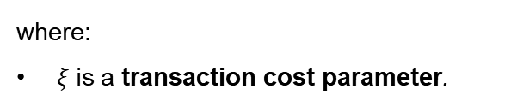
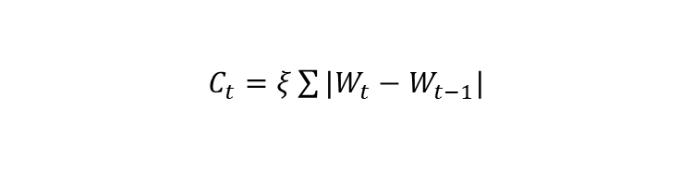
Deep Reinforcement Learning Problem Definition
State, Action and Reward
3. Reward
The reward function evaluates the agent’s portfolio performance by considering:
1. Portfolio Return $R_{t}$ (growth of the portfolio)
2. Transaction Cost $C_{t}$ (costs from adjusting weights)
3. Risk Penalty $V_{t}$ (to discourage high volatility)
Transaction Cost:
$C_{t}=ξ\sum{|W_{t}−W_{t−1}|}$
where:
$ξ$is a transaction cost parameter.

Slide 12
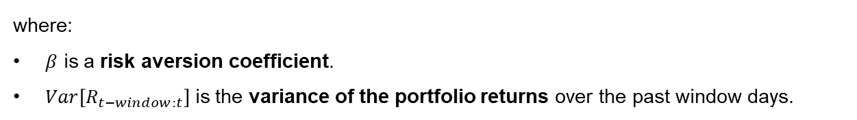
Deep Reinforcement Learning Problem Definition
State, Action and Reward
3. Reward
The reward function evaluates the agent’s portfolio performance by considering:
1. Portfolio Return $R_{t}$ (growth of the portfolio)
2. Transaction Cost $C_{t}$ (costs from adjusting weights)
3. Risk Penalty $V_{t}$ (to discourage high volatility)
Risk Penalty:
$$V_{t}=βVar[R_{t−window:t}]$$
where:
$β$ is a risk aversion coefficient.
$Var[R_{t−window:t}]$is the variance of the portfolio returns over the past window days.

Slide 13

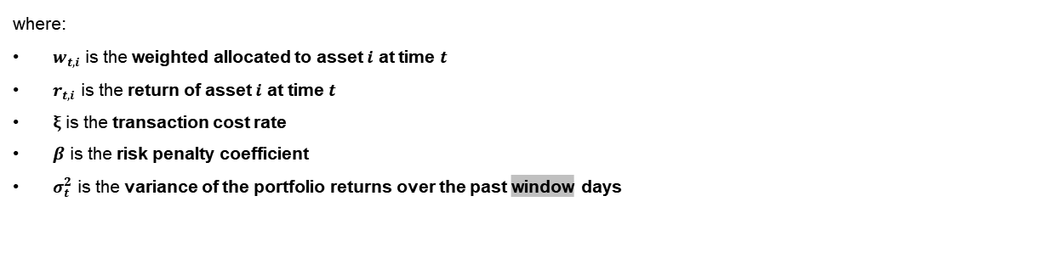

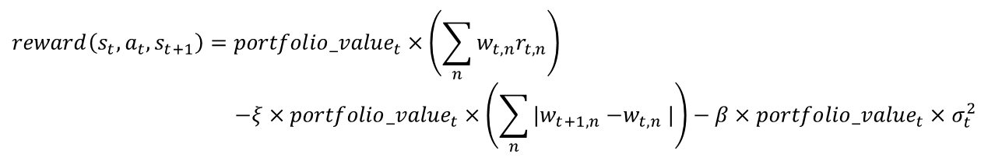
Deep Reinforcement Learning Problem Definition
State, Action and Reward
3. Reward Function (r)
${reward}_{t}=R_{t}−C_{t}−$ $V_{t}$
$$reward\left(s_{t},a_{t},s_{t+1}\right)={portfolio_value}_{t}×\left(\sum_{n}{w_{t,n}r_{t,n}}\right)$$
$$−ξ×{portfolio_value}_{t}×\left(\sum_{n}{{|w}_{t+1,n}{−w}_{t,n}|}\right)−β×{portfolio_value}_{t}×σ_{t}^{2}$$
where:
$w_{t,i}$ is the weighted allocated to asset $i$ at time $t$
$r_{t,i}$ is the return of asset $i$ at time $t$
$ξ$ is the transaction cost rate
$β$ is the risk penalty coefficient
$σ_{t}^{2}$ is the variance of the portfolio returns over the past window days

Slide 14
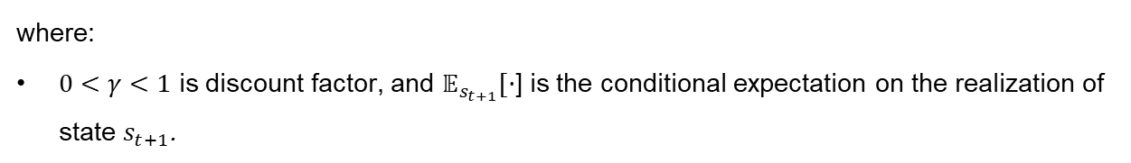
Deep Reinforcement Learning Problem Definition
Bellman Equation and Q-value Update
Policies are evaluated using an action-value function, $Q_{π}\left(s_{t},a_{t}\right)$ (i.e., the Q-function). Wiering and Otterlo (2012) expressed this function as a Bellman equation:
$$Q_{π}\left(s_{t},a_{t}\right)=𝔼_{s_{t+1}}\left[r_{t}\left(s_{t},a_{t},s_{t+1}\right)+γ𝔼_{s_{t+1,a_{t+1}}}\left[Q_{π}\left(s_{t+1},a_{t+1}\right)\right]\right]$$
where:
$0<γ<1$ is discount factor, and $𝔼_{s_{t+1}}[·$] is the conditional expectation on the realization of state $s_{t+1}$.
The updated Q-value is determined by multiplying the temporal difference error and learning rate and adding it to the current Q-value, thus we have:

Slide 15
Deep Reinforcement Learning Problem Definition
State, Action and Reward
Summary
Components | Description
State (s) | Asset prices (normalized) + previous portfolio weights
Action (a) | Adjustment to portfolio allocation
Reward (s) | Portfolio return – transaction costs – risk penalty

Slide 16
Model Building

Slide 17


Baseline Methods to Compare with DRL
Traditional Investment Strategies (Markowitz’s Modern Portfolio Theory)
Minimum Variance Strategy
Uses data from the past period (e.g. window=5 days in the code) to calculate the covariance matrix between assets.
Aims to minimize overall portfolio risk (measured as variance or standard deviation) by optimizing asset weights.
Maximum Sharpe Ratio Strategy
The Sharpe Ratio measures the ratio of a portfolio's excess return (the excess over the risk-free rate of return) to its volatility (i.e., risk).
Aims to maximize the Sharpe ratio of the portfolio by optimizing asset weights.
$$a^{∗}=argmin\{Var[recent portfolio returns]\}$$
$$sharpe ratio=\frac{Expected portfolio return −Risk free rate}{Portfolio Volatility}$$
$$a^{∗}=argmax\{Sharp Ratio\}$$

Slide 18
Deep Reinforcement Learning Model Building
TD3 Algorithm
TD3 (Twin Delayed Deep Deterministic Policy Gradient)
An actor-critic algorithm
Designed for continuous action spaces, improving stability and performance.
Key improvements: Twin Critic Networks, Delayed Policy Updates, Target Policy Smoothing, Target Networks & Polyak Averaging

Slide 19


Deep Reinforcement Learning Model Building
TD3 Algorithm
Target Policy Smoothing:
When computing the target action (for the next state), TD3 adds clipped Gaussian noise to the action output of the target actor.
This “smoothing” prevents the policy from exploiting minor errors in the value estimation by making the target Q-value less sensitive to small changes in the action.
Twin Critic Networks:
TD3 uses two separate critic networks to estimate the Q-value. When computing the target Q-value, it takes the minimum of the two critics’ estimates.
This addresses the overestimation bias that can occur in Q-learning when using the max operator.

Slide 20

Deep Reinforcement Learning Model Building
TD3 Algorithm
Delayed Policy Updates:
The actor (policy) network is updated less frequently than the critic networks.
This delay allows the critics to stabilize and provide more reliable gradients to update the actor
Target Networks & Polyak Averaging:
Blend a small fraction of the online network weights with the existing target weights.
Polyak averaging provide a stable and consistent reference during training, ensuring that the learning process is not disrupted by rapidly changing targets. The update rule is,

Slide 21
Deep Reinforcement Learning Model Building
Replay Buffer
Purpose:
Stores past experiences as tuples: (state, action, reward, next_state, done).
Samples mini-batches randomly to break the correlation between sequential observations.
Benefits:
Improved Sample Efficiency: Reuse experiences multiple times.
Stabilized Learning: Random sampling reduces temporal correlations.

Slide 22
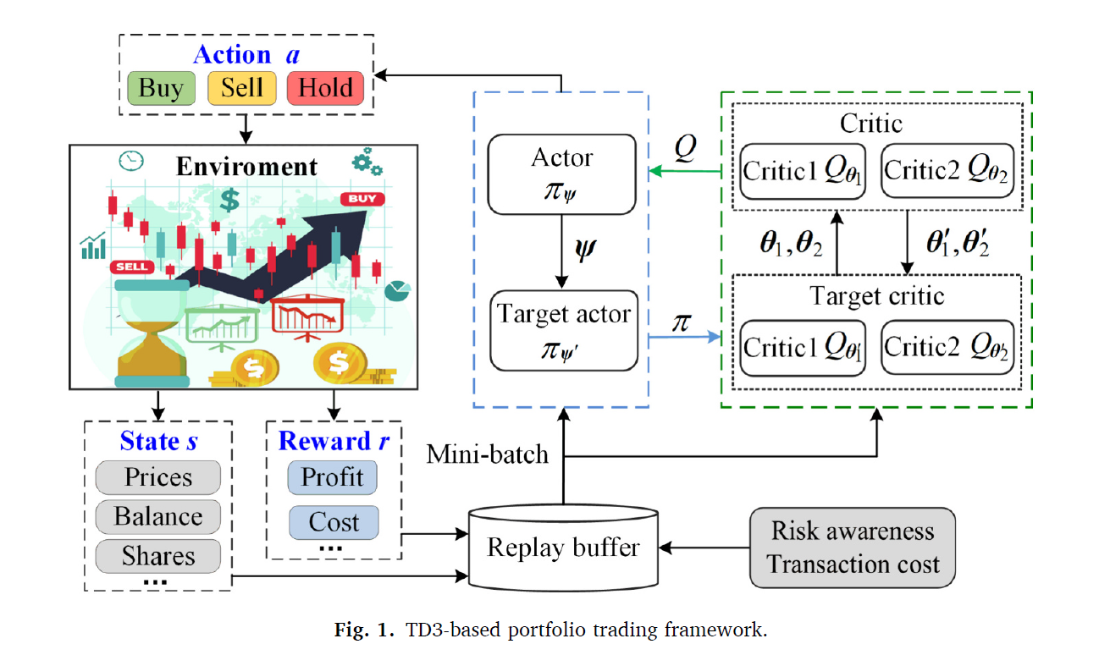
Deep Reinforcement Learning Model Building
TD3 Agent Training Loop
1. Interacting with the Environment :Observes the current state, actor network predicting best action first, returns the next state, a reward
2. Storing Experiences in a Replay Buffer
3. Critic Update (Every Training Step)
Sample a Batch
Policy Smoothing (for the target action)
Compute Target Q-Values
Calculate Critic Loss & Update
4. Delayed Actor Update (Every Few Steps)
policy_freq == 2
Update the Actor
5. Target Network Updates (Polyak Averaging)

Slide 23
Definition of Agent
TD3 with an Online Learning Algorithm and Off-policy Method
-Online Learning Algorithm
Agent interacts with the environment step-by-step (using a windowed data representation), collecting new data and updating the policy during training.
“online RL” in a simulated environment created by historical data
Collects experience and updates policy in real-time
-Off-policy Method
TD3 stores transitions in a replay buffer and re-samples from them many times for training, even though new samples may come from a slightly updated policy.

Slide 24
Result Analysis

Slide 25

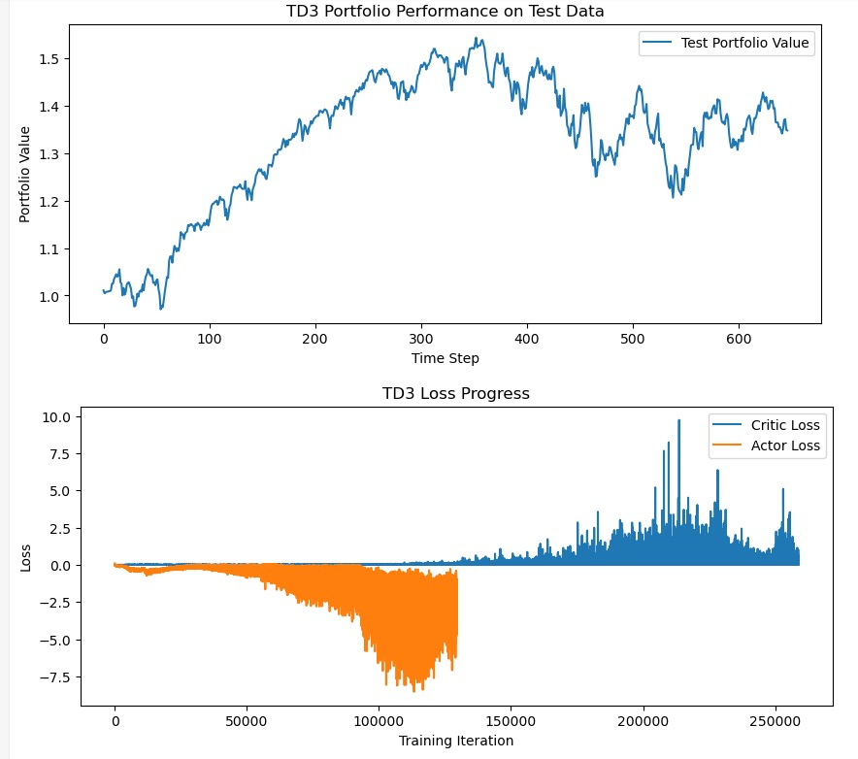
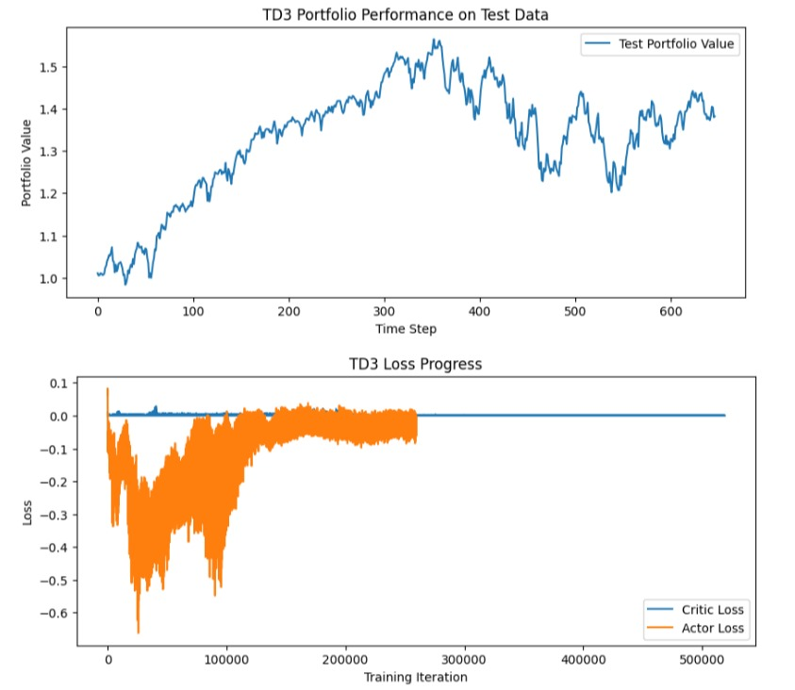

Conclusion
First, we adjusted the learning rate and number of episodes to balance exploration and exploitation, ensuring more stable training, better convergence, and improved generalization in portfolio performance.
Learning Rate: 1e-4 & Episode: 100
Learning Rate: 5e-5 & Episode: 200
Initial Cumulative Return: 33%
New Cumulative Return: 37%
Smooth and stable throughout training
Converges towards a flat line
Minimal fluctuations

Slide 26
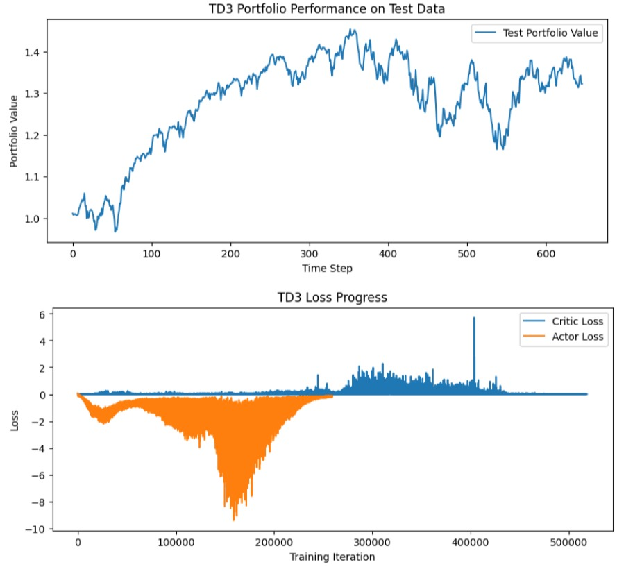
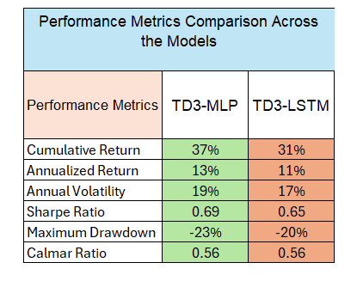
Conclusion
TD3-MLP model achieves higher cumulative and annualized return compared to the TD3-LSTM version.
TD3-LSTM
TD3-MLP

Slide 27
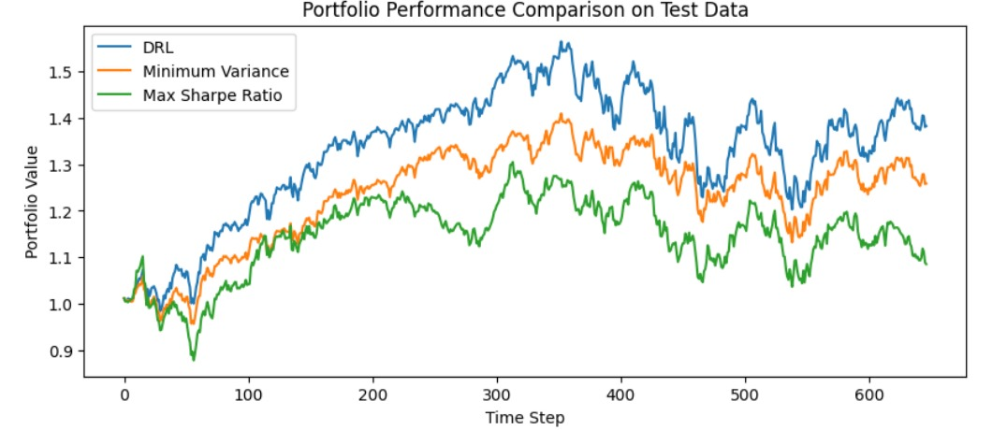
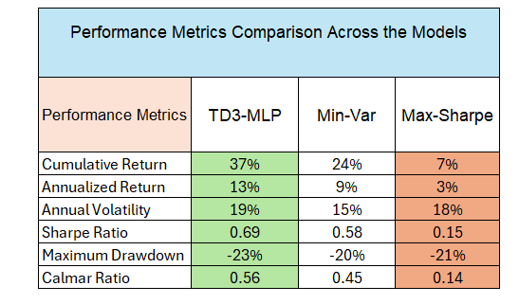
Conclusion
Our DRL (TD3 with MLP) model outperformed traditional benchmarks like the Minimum Variance and Maximum Sharpe Ratio strategies, achieving higher cumulative returns and better risk-adjusted metrics for S&P100 index within complex, uncertain, dynamic, and large-scale financial trading environments.

Slide 28
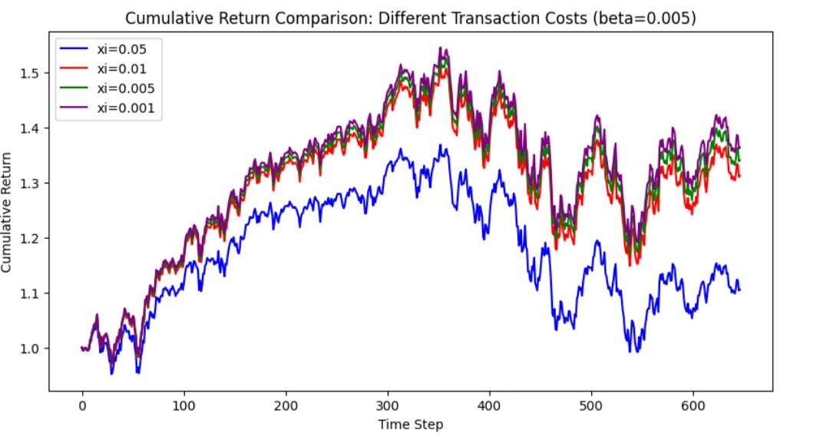
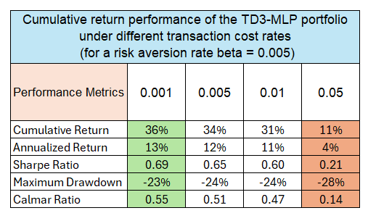
Conclusion
Furthermore, higher transaction costs lead to reduced trading, lowering portfolio returns. At a 0.05 cost rate, the learning-based portfolio underperformed significantly compared to the 0.001 scenario.

Slide 29
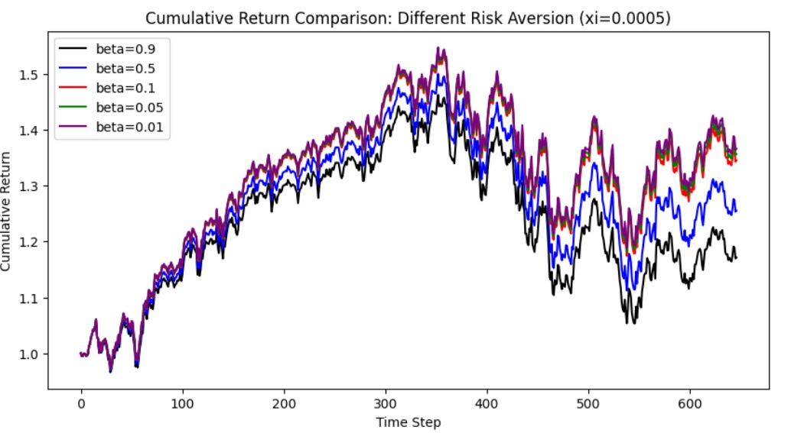
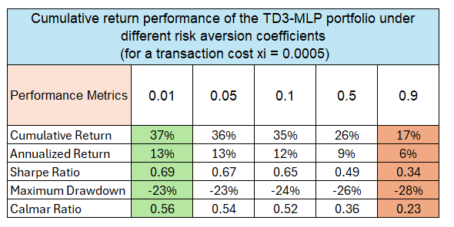
Conclusion
Finally, increasing the beta parameter, representing risk aversion, led to more stable portfolios but at the cost of lower returns.

Slide 30
Learnings and Future Directions
Model's performance is highly sensitive to hyperparameters, including the discount factor, learning rate, episodes size, etc.
Adjusting the risk aversion and transaction cost parameters revealed a clear trade-off.
We believe that DRL-based portfolio optimization models show promising results.
However, there are some areas for further exploration:
Expanding training datasets to include diverse market conditions, including recessions and bull markets,
Extending the framework to include alternative assets, such as cryptocurrencies, commodities, forex markets to improve diversification and robustness,
Expanding the model to high-dimensional portfolios with thousands of assets while maintaining computational efficiency is another promising direction,
Enhancing the DRL framework with automated risk management features, such as dynamic stop-loss and rebalancing rules, can protect portfolios during market downturns,
Implementing a dynamic risk aversion parameter (β) that adjusts based on market conditions.

Slide 31
Thank you for
Listening

Slide 32
Q & A

Slide 33
References
Jiang, Y., Olmo, J., & Atwi, M. (2024). Deep reinforcement learning for portfolio selection. Global Finance Journal, 62, 101016.

